Slide 1

Decomposing New Zealand’s Electricity Demand using: stl, mstl, and stR
Kane Williams (pkw21@uclive.ac.nz)
STAT456-24S2 – Time Series and Stochastic Processes

Slide 2
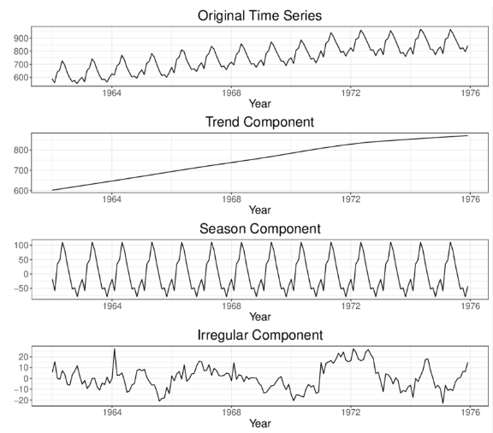
Presentation Overview
1) New Zealand’s Electricity Demand
2) stl/mstl
3) stR
4) Comparisons
I) Features Extracted,
II) Residual Analysis,
III) Benchmark (Time)
5) Next Steps
– Decomposition with LOESS (~1990)
– Decomposition with Regression (~2021)
A Time Series Decomposition

Slide 3
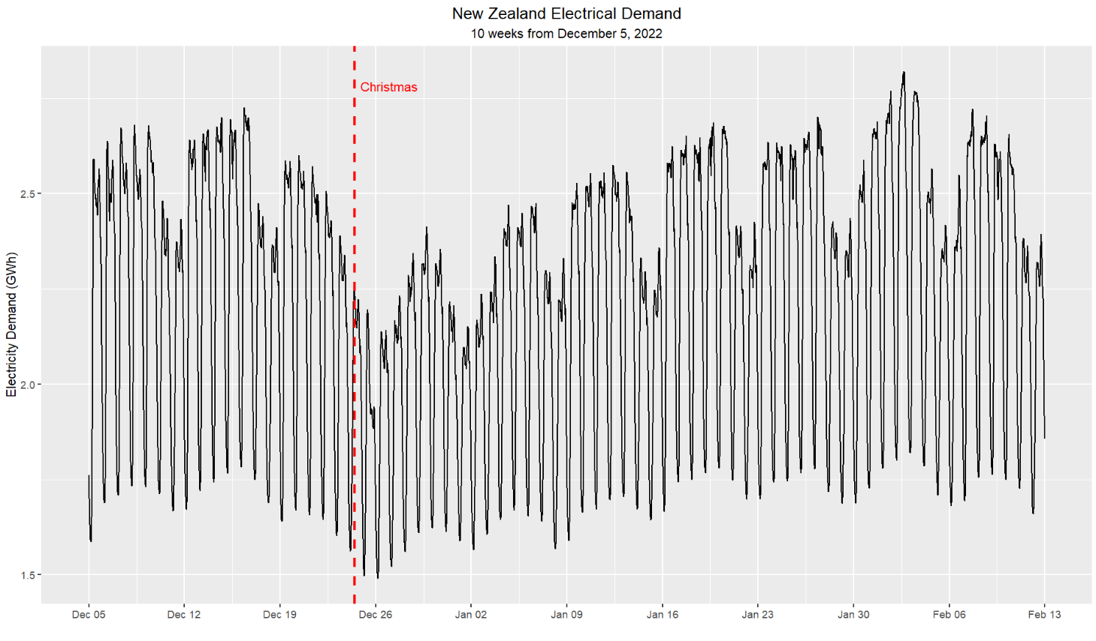
New Zealand’s Electricity Demand
~1/3 Households ~1/3 Industry (wood, metals). ~1/4 Commercial
Influenced by:
Day of Year
Day of the Week
Hour of the Day
Temperature
Holidays
…
Data Used:
10 Weeks from 05-Dec-2022.
All of New Zealand
Half-hourly.
Sourced from Electricity Authority.
Un-logged data

Slide 4
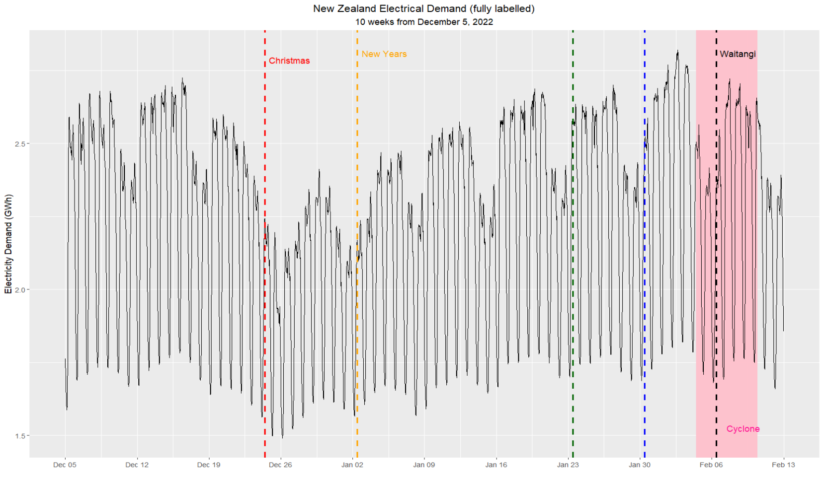
Wellington
Annv.
Auckland
Annv.
Gabriel: 5Feb -> 11Feb
*Holidays labelled when Observed.

Slide 5
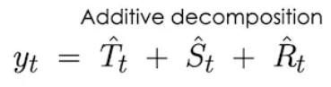
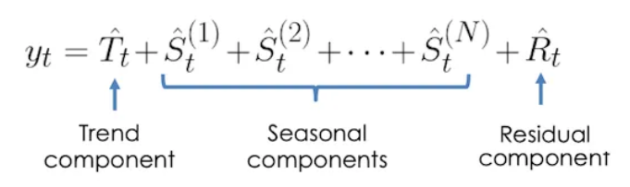
stl - Seasonal-Trend decomposition using LOESS
Authors: Cleveland (1990)
Basic Idea: Non-parametric Smoothing Windows
Designed to be:
Simple to Use
Fast to Compute
Flexible (modify trend/seasonal smoothing using s.window/t.window)
(and mstl) – Multiple Seasonal-Trend decomposition using LOESS
Authors: Bandara, Hyndman, Bergmeir (2021)
Basic Idea: Add more seasonal components.
Algorithm: Initialize all seasonal components to 0. Subtract trend. Update each seasonal smallest to largest. Repeat. Repeat.
Source for images: https://towardsdatascience.com/multi-seasonal-time-series-decomposition-using-mstl-in-python-136630e67530

Slide 6
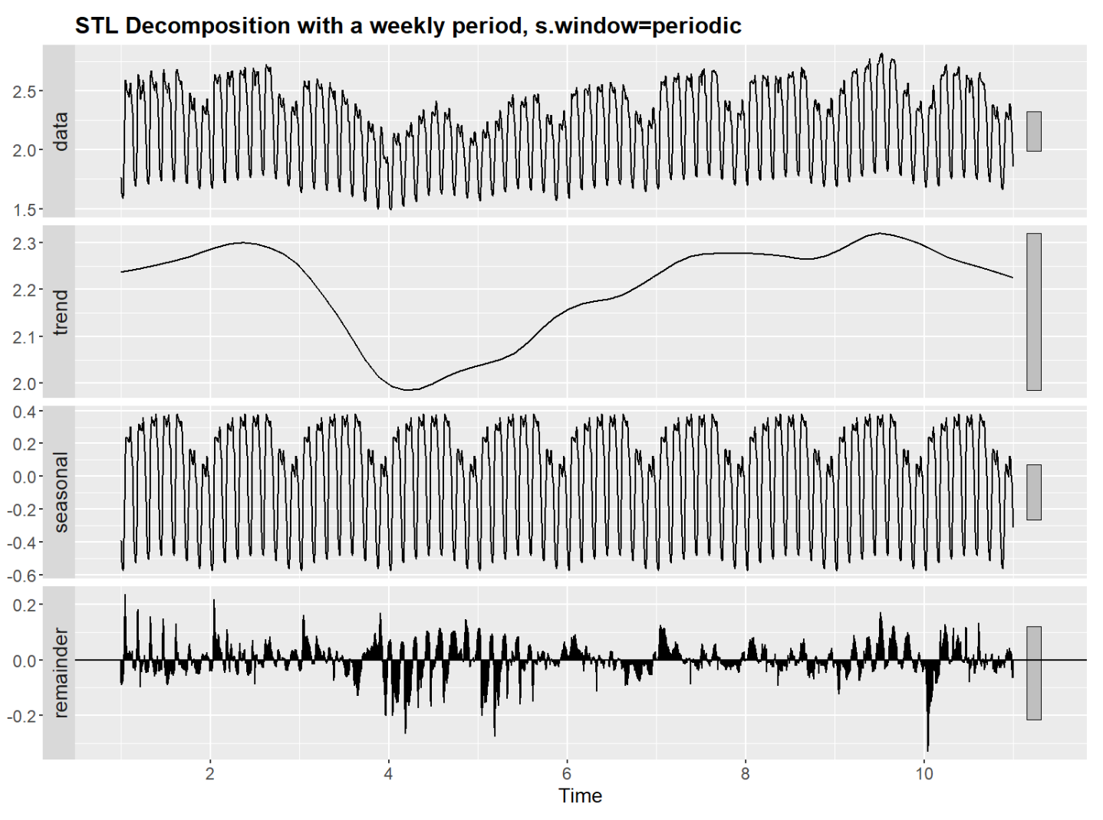
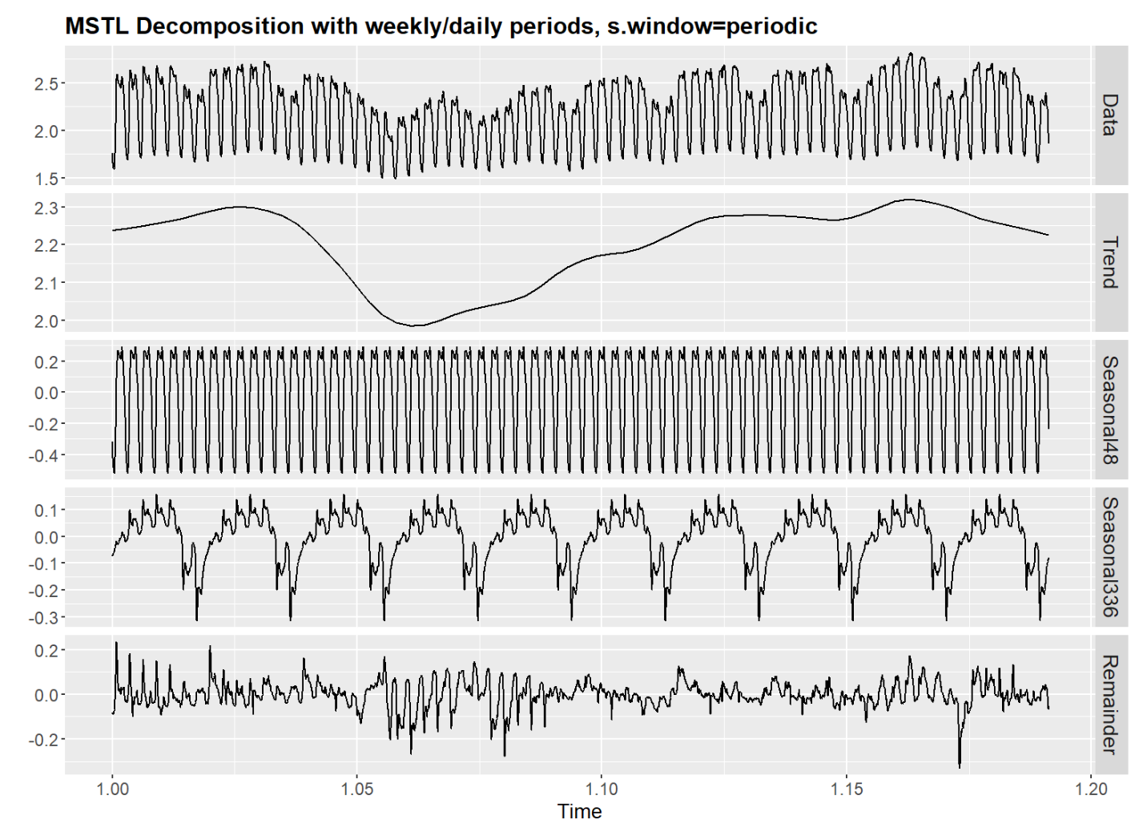
Interesting Observations:
Residuals are exactly the same.
Large residual around early February.
Clear cyclical patterns in residuals – unexplained “sub-seasonality”.

Slide 7
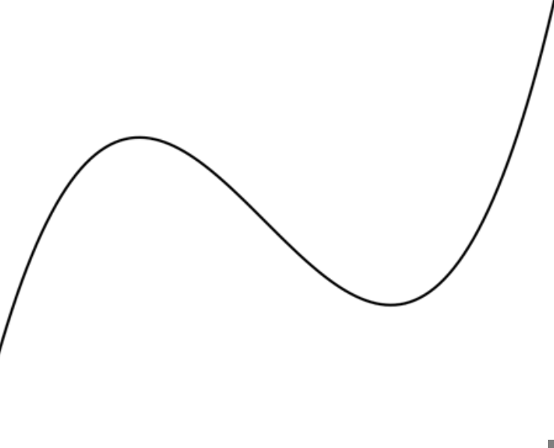
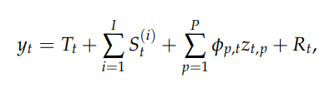
stR - Seasonal-Trend decomposition using Regression
Authors: Dokumentov and Hyndman (2021)
Basic Principle: Perform OLS to guarantee “smooth” components.
Allows for:
Non-integer Periods
Complex Topologies
Covariates such as Temperature
Interaction Effects
Since it is Parametric (it assumes something about the data: i.e. “smoothness”) it can also form confidence intervals!

Slide 8
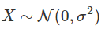

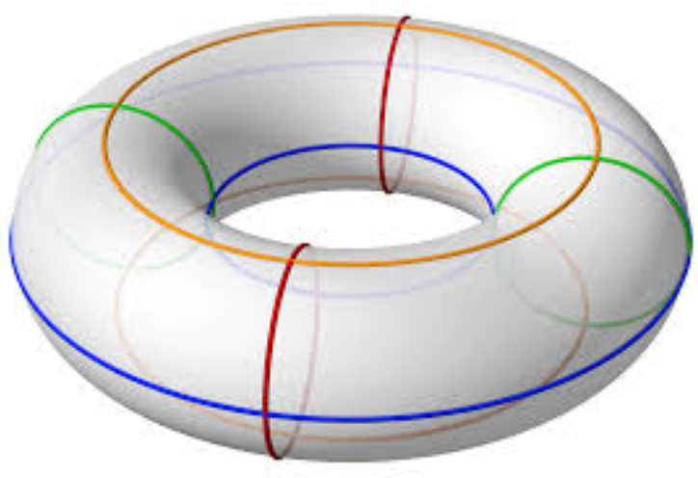
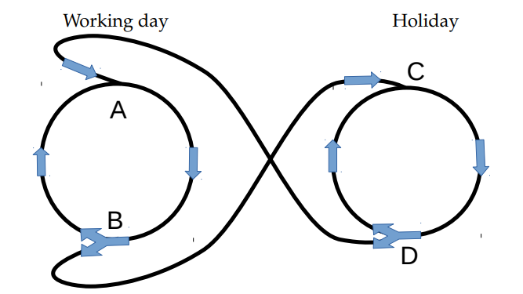
stR – High Level
Smooth means that each component’s second derivative
Trend
Day of Week
Day of Week
Can use “Knots” to define arbitrary topologies
Day of Week

Slide 9
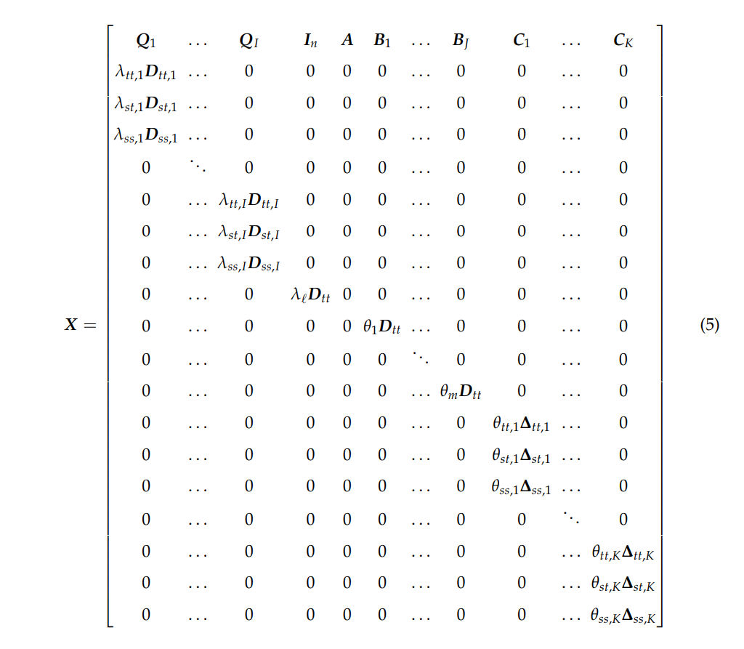
stR - Technicalities
Mostly beyond me.
Involves optimizing (i.e. OLS to make “smooth”) a gigantic sparse matrix encoding previously discussed information.
Regularization term, so similar to Ridge Regression.
Cross-Validation to find optimal hyperparameters (e.g. sigma^2).

Slide 10
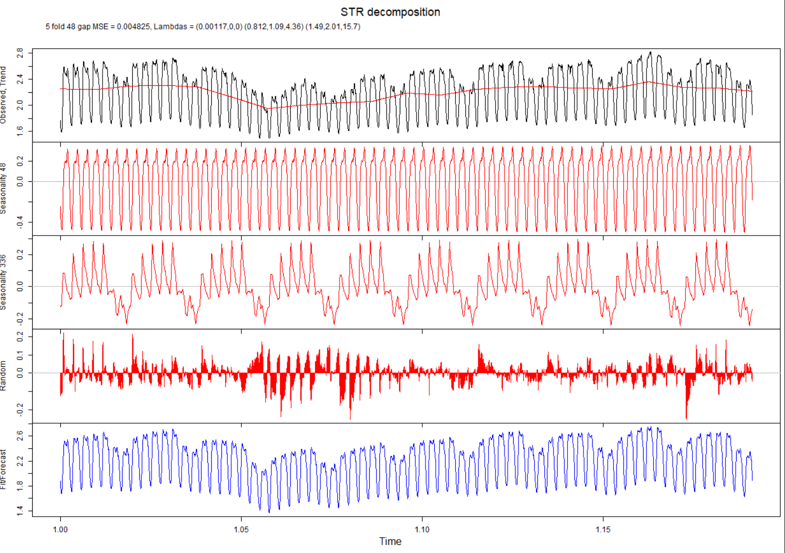

Slide 11
Interesting Observations in stR:
Morning effect has been captured by Weekly component (possible interaction)
Waitangi Day residual is less prominent with stR.
“Outlier” Thursday before Cyclone Gabriel less difficult to see with stR.

Slide 12
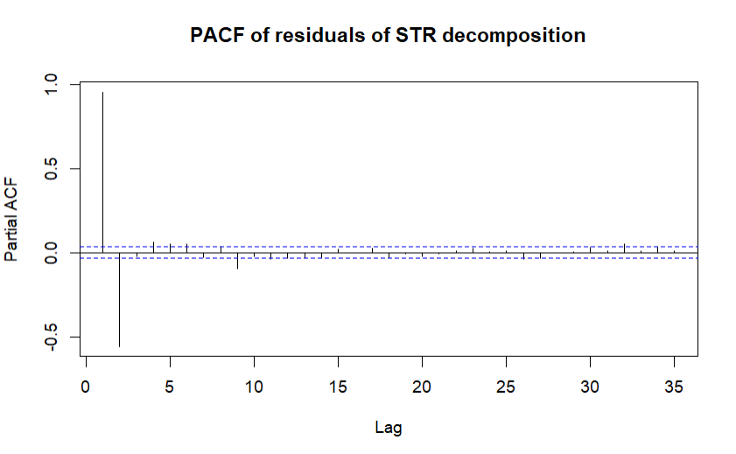
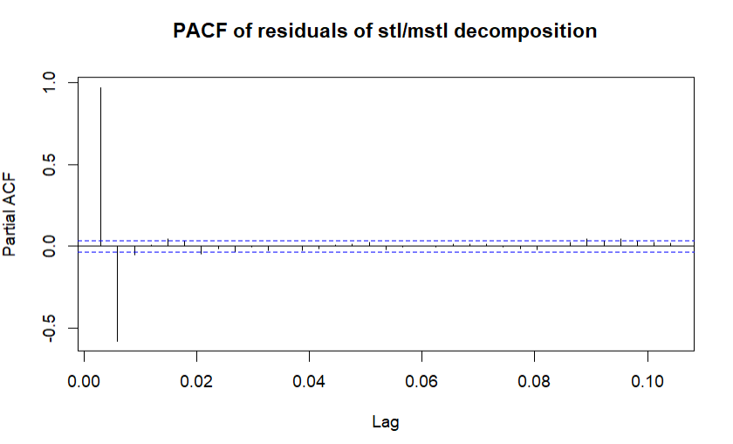
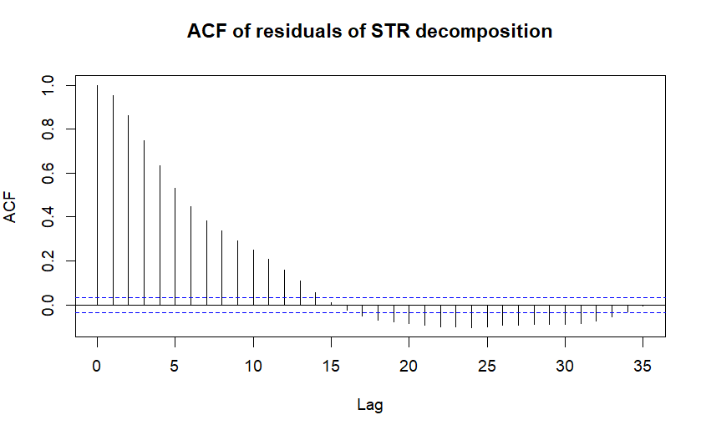
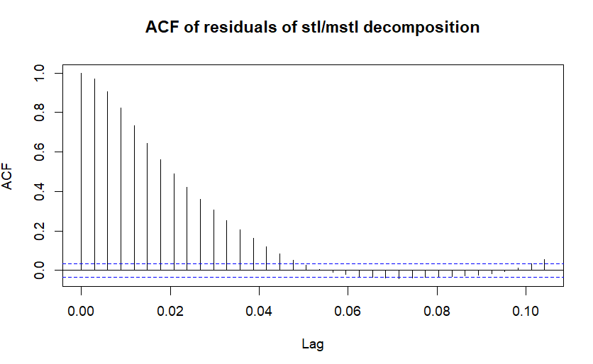
Residual Analysis (PACF/ACF)

Slide 13
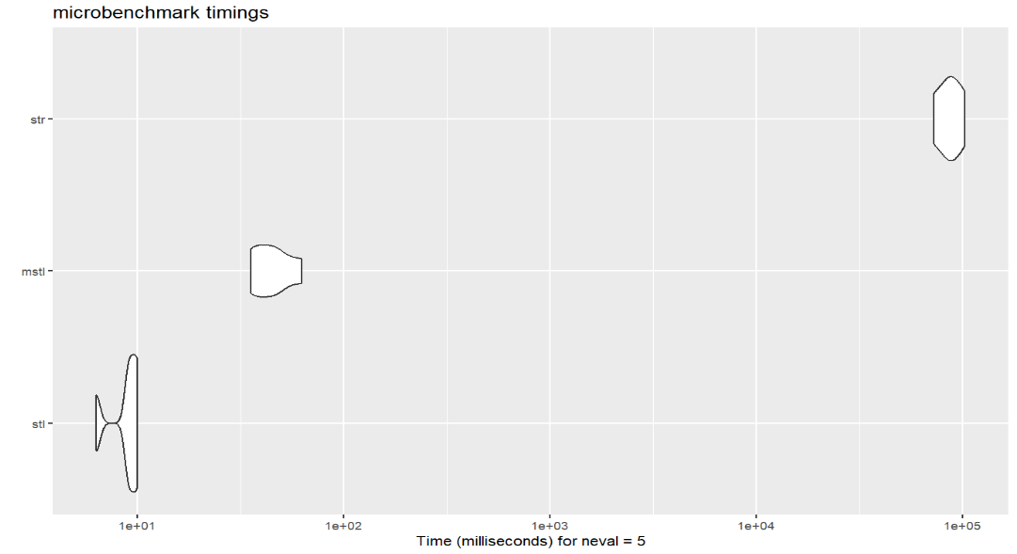
Benchmark
> 1 min
~5ms
~1ms

Slide 14
Conclusions
Both methods are viable.
Not replacements for each other.
Pick out different features.
Maybe mstl could be better at short-range anomaly detection.
Maybe stR could be better at picking out interaction effects
stR better for in-built confidence intervals.
mstl better for time-sensitive work.

Slide 15


Possible Next Steps
Analysing Long-term data (+ yearly seasonality).
Incorporating temperature/COVID-19 covariates.
Incorporating Holidays explicitly.
Forecasting using all methods and comparing results.
Combining decompositions. (first str, and mstl residuals).

Slide 16
Thanks, any questions?

